Slide 1
Spring AOP. JDBC

Slide 2
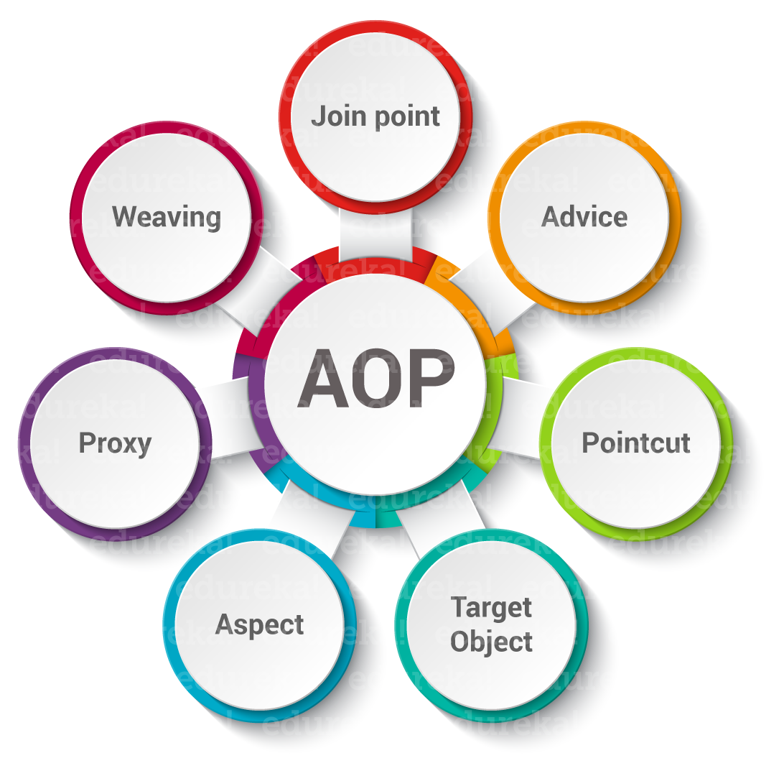
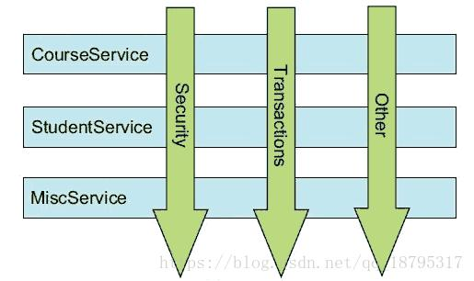
Spring AOP

Slide 3
Spring AOP.
public class AgentAOPDemo { public static void main(String... args) { Agent target = new Agent(); ProxyFactory pf = new ProxyFactory(); pf.addAdvice(new AgentDecorator()); pf.setTarget(target); Agent proxy = (Agent) pf.getProxy(); target.speak(); System.out.println(""); proxy.speak(); } }
public class Agent { public void speak() { System.out.print("Bond"); } }
public class AgentDecorator implements MethodInterceptor { public Object invoke(MethodInvocation invocation) throws Throwable { System.out.print("James "); Object retVal = invocation.proceed(); System.out.println("!"); return retVal; } }

Slide 4
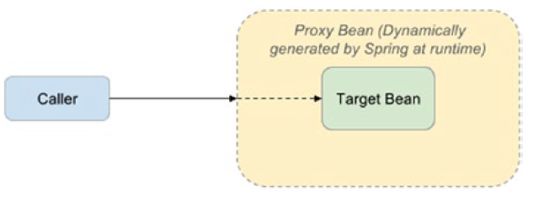
Spring AOP

Slide 5
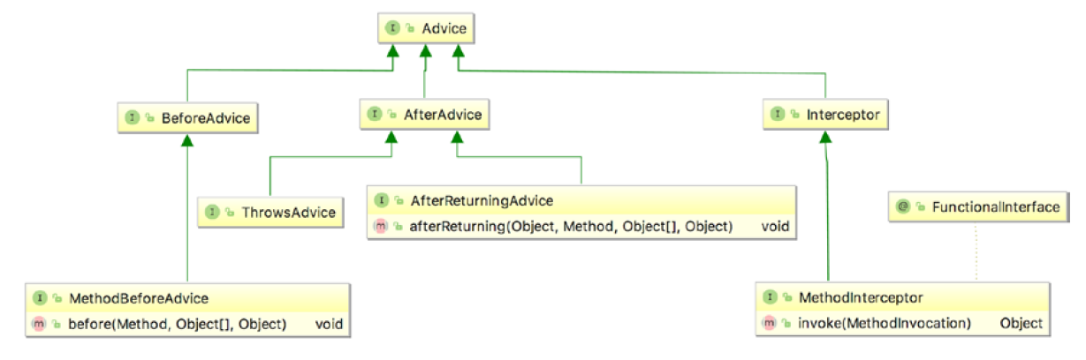
Spring AOP

Slide 6
Spring AOP
public class Guitarist implements Singer { private String lyric="You're gonna live forever in me"; @Override public void sing(){ System.out.println(lyric); } }
public class SimpleBeforeAdvice implements MethodBeforeAdvice { public static void main(String... args) { Guitarist johnMayer = new Guitarist(); ProxyFactory pf = new ProxyFactory(); pf.addAdvice(new SimpleBeforeAdvice()); pf.setTarget(johnMayer); Guitarist proxy = (Guitarist) pf.getProxy(); proxy.sing(); } @Override public void before(Method method, Object[] args, Object target) throws Throwable { System.out.println("Before '" + method.getName() + "', tune guitar."); } }

Slide 7
Spring AOP. AspectJ
@Component("documentarist") public class NewDocumentarist { protected GrammyGuitarist guitarist; public void execute() { guitarist.sing(); Guitar guitar = new Guitar(); guitar.setBrand("Gibson"); guitarist.sing(guitar); guitarist.talk(); } @Autowired @Qualifier("johnMayer") public void setGuitarist(GrammyGuitarist guitarist) { this.guitarist = guitarist; } }
@SpringBootApplication public class Application { private static Logger logger = LoggerFactory.getLogger(Application.class); public static void main(String[] args) throws Exception { ConfigurableApplicationContext ctx = SpringApplication.run(Application.class, args); assert (ctx != null); NewDocumentarist documentarist = ctx.getBean("documentarist", NewDocumentarist.class); documentarist.execute(); System.in.read(); ctx.close(); } }
@Component("johnMayer") public class GrammyGuitarist{ public void sing() { System.out.println("sing: Gravity is working against me\n" + "And gravity wants to bring me down"); } public void sing(Guitar guitar) { System.out.println("play: " + guitar.play()); } public void rest(){ System.out.println("zzz"); } public void talk(){ System.out.println("talk"); } }

Slide 8
Spring AOP
@Component @Aspect public class AnnotatedAdvice { @Pointcut("execution(*kz.one.aop..sing*(kz.one.aop.Guitar)) && args(value)") public void singExecution(Guitar value) { } @Pointcut("bean(john*)") public void isJohn() { } @Before("singExecution(value) && isJohn()") public void simpleBeforeAdvice(JoinPoint joinPoint, Guitar value) { if(value.getBrand().equals("Gibson")) { System.out.println("Executing: " + joinPoint.getSignature().getDeclaringTypeName() + " " + joinPoint.getSignature().getName() + " argument: " + value.getBrand()); } } @Around("singExecution(value) && isJohn()") public Object simpleAroundAdvice(ProceedingJoinPoint pjp, Guitar value) throws Throwable { System.out.println("Before execution: " + pjp.getSignature().getDeclaringTypeName() + " " + pjp.getSignature().getName() + " argument: " + value.getBrand()); Object retVal = pjp.proceed(); System.out.println("After execution: " + pjp.getSignature().getDeclaringTypeName() + " " + pjp.getSignature().getName() + " argument: " + value.getBrand()); return retVal; } }
@Configuration @ComponentScan(basePackages = {“kz"}) @EnableAspectJAutoProxy(proxyTargetClass = true) public class AppConfig { }

Slide 9
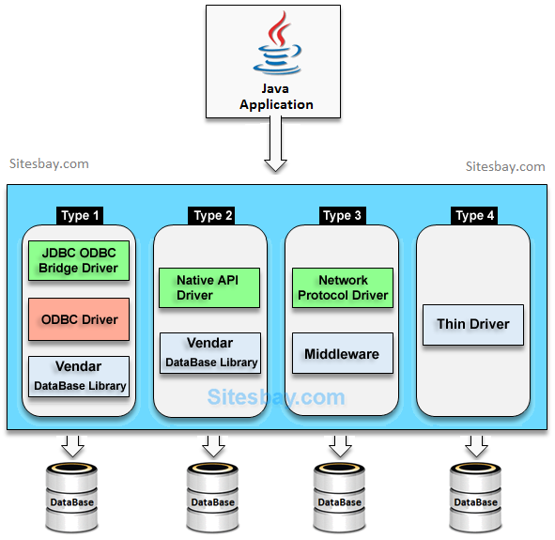
Spring JDBC Support
public class PlainSingerDao implements SingerDao { private static Logger logger = LoggerFactory.getLogger(PlainSingerDao.class); static { try { Class.forName("com.mysql.cj.jdbc.Driver"); } catch (ClassNotFoundException ex) { logger.error("Prblem loadng DB dDiver!", ex); } } private Connection getConnection() throws SQLException { return DriverManager.getConnection( "jdbc:mysql://localhost:3306/musicdb?useSSL=true", "prospring5", "prospring5"); }

Slide 10
Spring JDBC Support
Spring JDBC Packages:
org.springframework.jdbc.core
org.springframework.jdbc.datasource
org.springframework.jdbc.object
org.springframework.jdbc.support
org.springframework.jdbc.config

Slide 11
Spring JDBC Support
@Configuration @PropertySource("classpath:db/jdbc2.properties") @ComponentScan(basePackages = “kz") public class AppConfig { private static Logger logger = LoggerFactory.getLogger(AppConfig.class); @Value("${driverClassName}") private String driverClassName; @Value("${url}") private String url; @Value("${username}") private String username; @Value("${password}") private String password; @Bean public static PropertySourcesPlaceholderConfigurer propertySourcesPlaceholderConfigurer() { return new PropertySourcesPlaceholderConfigurer(); } @Bean(destroyMethod = "close") public DataSource dataSource() { try { BasicDataSource dataSource = new BasicDataSource(); dataSource.setDriverClassName(driverClassName); dataSource.setUrl(url); dataSource.setUsername(username); dataSource.setPassword(password); return dataSource; } catch (Exception e) { logger.error("DBCP DataSource bean cannot be created!", e); return null; } } }
<?xml version="1.0" encoding="UTF-8"?> <beans xmlns="http://www.springframework.org/schema/beans" xmlns:xsi="http://www.w3.org/2001/XMLSchema-instance" xmlns:util="http://www.springframework.org/schema/util" xmlns:p="http://www.springframework.org/schema/p" xsi:schemaLocation="http://www.springframework.org/schema/beans http://www.springframework.org/schema/beans/spring-beans.xsd http://www.springframework.org/schema/util http://www.springframework.org/schema/util/spring-util.xsd"> <bean id="dataSource" class="org.springframework.jdbc.datasource.DriverManagerDataSource" p:driverClassName="#{jdbc.driverClassName}" p:url="#{jdbc.url}" p:username="#{jdbc.username}" p:password="#{jdbc.password}"/> <util:properties id="jdbc" location="classpath:db/jdbc2.properties"/> </beans>
jdbc.driverClassName=com.mysql.cj.jdbc.Driver jdbc.url=jdbc:mysql://localhost:3306/musicdb?useSSL=true jdbc.username=prospring5 jdbc.password=prospring5

Slide 12
Spring JDBC Support
@Configuration public class EmbeddedJdbcConfig { private static Logger logger = LoggerFactory.getLogger(EmbeddedJdbcConfig.class); @Bean public DataSource dataSource() { try { EmbeddedDatabaseBuilder dbBuilder = new EmbeddedDatabaseBuilder(); return dbBuilder.setType(EmbeddedDatabaseType.H2) .addScripts("classpath:db/h2/schema.sql", "classpath:db/h2/test-data.sql").build(); } catch (Exception e) { logger.error("Embedded DataSource bean cannot be created!", e); return null; } } @Bean public SingerDao singerDao(){ JdbcSingerDao dao = new JdbcSingerDao(); dao.setDataSource(dataSource()); return dao; } }
public interface SingerDao { List<Singer> findNameById();
}
public class JdbcSingerDao implements SingerDao, InitializingBean { private DataSource dataSource;
public void setDataSource(DataSource dataSource) { this.dataSource = dataSource; }
public void afterPropertiesSet() throws Exception { if (dataSource == null) { throw new BeanCreationException( "Must set dataSource on SingerDao"); }
@Override
public String findNameById(Long id) { throw new NotImplementedException("findNameById"); }

Slide 13
Spring JDBC Support
@Component //@Repository public class JdbcSingerDao implements SingerDao, InitializingBean { private JdbcTemplate jdbcTemplate; @Autowired public void setJdbcTemplate(JdbcTemplate jdbcTemplate) { this.jdbcTemplate = jdbcTemplate; } @Override public String findNameById(Long id) { return jdbcTemplate.queryForObject( "SELECT first_name || ' ' || last_name FROM singer WHERE id = ?", new Object[]{id}, String.class); } @Override public String findFirstNameById(Long id) { return jdbcTemplate.queryForObject( "SELECT first_name FROM singer WHERE id = ?", new Object[]{id}, String.class); }
@Configuration public class EmbeddedJdbcConfig { private static Logger logger = LoggerFactory.getLogger(EmbeddedJdbcConfig.class); @Bean public DataSource dataSource() { try { EmbeddedDatabaseBuilder dbBuilder = new EmbeddedDatabaseBuilder(); return dbBuilder.setType(EmbeddedDatabaseType.H2) .addScripts("classpath:db/h2/schema.sql", "classpath:db/h2/test-data.sql").build(); } catch (Exception e) { logger.error("Embedded DataSource bean cannot be created!", e); return null; } } @Bean public JdbcTemplate jdbcTemplate(){ JdbcTemplate jdbcTemplate = new JdbcTemplate(); jdbcTemplate.setDataSource(dataSource()); return jdbcTemplate; }

